Slide 1
NATIONAL AIDS CONTROL COUNCIL
Differentiated Models of HIV Prevention
Dr Nduku Kilonzo
CEO, National AIDS Control Council, Kenya

Slide 2
I AM Team Kenya! Welcome to our Symposia
Date: Monday, July 23, 2018
Time: 10:15-12:15pm
Venue: Elicium I
Ending the AIDS epidemic and Achieving Universal Health Coverage by 2030 in Africa
Date: Tuesday, July 24, 2018
Time: 18:30-20:30
Venue: E105-108
Kenya: Leadership and Innovation for Results in eMTCT and Adolescent Care
Date: Wednesday, July 25, 2018
Time: 7:00-8:30am
Venue: E105-108
Youth Leadership in Action: Lessons from Kenya and Beyond
Date: Thursday, July 26, 2018
Time: 7:00-8:30am
Venue: E105-108
The Elusive 90:90:90: The Experience of Kenya as an Early Adopter of Evidence
Date: Friday, July 27, 2018
Time: 7:00-8:30am
Venue: G104-105
From Research to Real world settings; scaling up PrEP within National Programs.
Notes:
I would like to start by thanking some very special people who have come today in support of team Kenya and myself. H.E the First Lady of the Republic of Kenya, Margaret Kenyatta, the Chief Administrative Secretary of the Ministry of Health, my Chair of the Board of the National AIDS Control Council, team Kenya, my friends and colleagues and my very special parents Monica and Pascal Kilonzo.
I also take this opportunity to welcome you all to the Kenya satellite sessions on our experiences and lessons with 90-90-90, and being the a pioneer in the scale up of HIV PrEP, and also to The team Kenya stand at 112
I thank the International AIDS Society for this opportunity to speak on matters HIV prevention, a subject that is close to my heart and one which I have and will continue to advocate

Slide 3
Disclosures
I have no disclosures to make
I have no conflicts of interest

Slide 4
Differentiated Models of HIV Prevention
Where are we coming from?
Where are we at now?
What lessons have we learnt?
How will we get there (where we need to go)?

Slide 5
Preventing transmission and acquisition of HIV: A timeline
Male & female condoms
Male circumcision
Harm reduction
Carey, 1992
Weller, Cochrane DBS 2002
Auvert, PloS Med 2005; Bailey, Lancet 2007; Gray, Lancet 2007
Ongoing research
STI Treatment
Ljungberg, AIDS 1996
Des Jarlais, Lancet 1996 Hurley, Lancet 1997
Treatment as prevention
Grosskurth, Lancet 2000,
(likely to work mainly in HIV epidemics /sub-populations with high bacterial STIs)
Vaccines
Vaginal ring
Antibodies
Long-acting
Injectable ARVs
Early population-level
successes (late 1980s)
Cohen, NEJM, 2011; Donnell, Lancet 2010; Tanser, Science 2013
HIV testing & counselling
Behavior change (Uganda)
Oral pre-exposure prophylaxis
Coates, Lancet 2000
Sweat, Lancet 2011
(effects mostly for persons who test HIV positive and couples)
Stoneburner, Science 2004
Grant, NEJM 2010 (MSM)
Baeten, NEJM 2012 (Couples)
Paxton, NEJM 2012 (Heterosex.); Choopanya, Lancet 2013 (PWID)
100% Condom use (Thailand)
Post-exposure prophylaxis
Hanenberg, Lancet 1994
?
Scheckter M, 2002
1990’s
2000’s
2020’s
2030
1980’s
Notes:
When I was asked to talk about differentiated HIV prevention, I reflected on the expectations for a few weeks. Three important perspectives emerged for me that I wish to start with.
The first is that differentiation has increasingly been used as the panacea for strengthening capacity of health systems to deliver
While recognizing this as an important approach that has shifted global thinking for the HIV epidemics, I am also acutely aware that differentiation will only work where there are services in the first place.
There are significant gaps in gaps in access and coverage of HIV prevention interventions and many people at risk of new infections are not empowered to seek or use available services. And this remains a key challenge for HIV prevention.
As Jared Baten has consistently said about HIV PrEP, it only works when taken. Any bio-medical HIV prevention intervention works only when used.

Slide 6
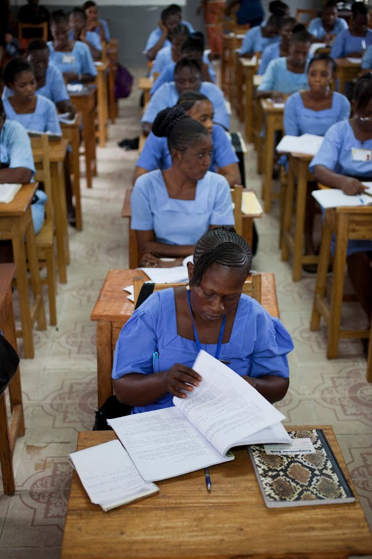
Combination Prevention – Proven Impact
– Economic Empowerment of women and girls (IMAGE studies; cash transfer programmes)
– Secondary education for girls and young women and girls
– Community empowerment (sex workers in India)
– Harm reduction policies

Slide 7
Global Health Arrangements
Purposed vehicles
UNAIDS, National AIDS Commissions – in-Coutry coordination (one strategy, coordination, one M & E)
Funding mechanisms and resources – PEPFAR, Global Fund, UNITAID
Global alliances – Civil society, PLHIV,
Research institutions – IAVI, KAVI
Common data collection and collation mechanisms for decision making - Routine surveys, annual estimates,
Notes:
Looking back at when HIV prevention was the only option, and treatment was either not available or affordable, the global community pulled together for prevention.
Civil society and in particular people living with HIV, pushed at the boundaries. I am reminded of the opening plenary, where Dorothy Onyango represented that voice.
The global community coalesced around research and resouces.
Governments took ownership and some leadership. Countries, including some that criminalize drug use, homosexuality and sex work, begun to create enabling environments for service delivery. India has documented a programme reaching and empowering more than 300,000 sex workers and still their legislation is far from perfect.
Kenya is providing HIV testing to young people even with age caveats in legislation. They organized multi-sector action and invested in service delivery systems.
Communities mobilized for services and for advocacy.
The numbers of new infections and deaths reduced drastically.
And while today, there are questions about the value of purposed vehicles, they were key to changing the narrative and deflecting a growing epidemic

Slide 8
Delivering HIV Prevention
Where are we coming from?
Where are we at now?
What lessons have we learnt?
How will we get there (where we need to go)?

Slide 9
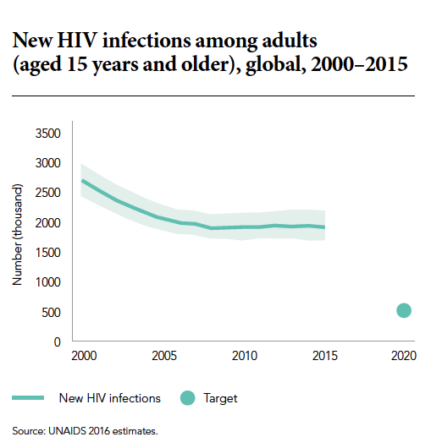
We have a HIV Prevention Crisis! Our numbers of new infections have flat-lined to approx. 1.8 million per year
Notes:
This brings me to my second and important reflection on differentiation is that we have a HIV prevention crisis!
Despite the successes that I have spoken about, and the significant progress in reducing incidence in the 1990’s, in the last decade, we have nearly 5,000 new infection every day! Continously, consistently. 1. 7 million people became newly infected with HIV in 2017.
As Prof. Dybul noted during the JLI SESSION, and noted by UNAIDS it is likely we shall see a resurge of the epidemic
In 2016 we made commitments in the political declaration, of the high level meeting. We, the global community, Governments and all stakeholders committed to reduce new infections to no more than 500,000 in 2020, which reflects a 75% decline in new infections.
we are off-track to this goal and therefore the goal of ending AIDS will not be achieved with the current trajectory, and we, collectively, will not meet our targets. We shall fail if we do not do something drastic

Slide 10
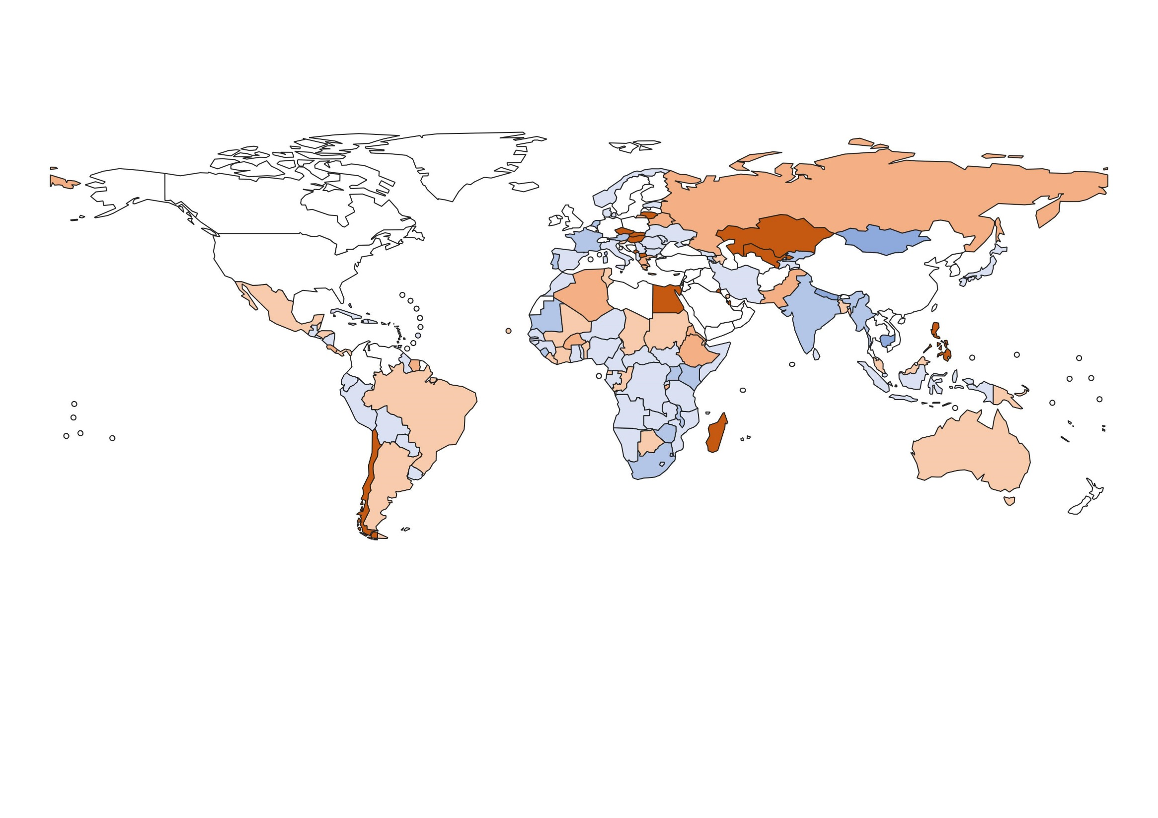
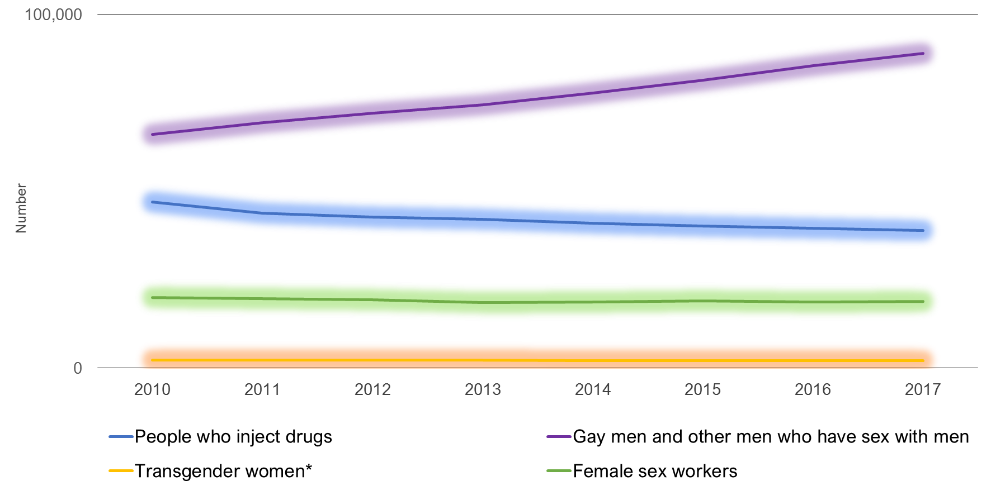
Percent change in new HIV infections among adults (15 years and older), from 2010 to 2017
≥50% decrease
25 – 49% decrease
0 – 24% decrease
≥50% increase
25 – 49% increase
1 – 24% increase
Data not available
Notes:
Where are the challenges?
We have a growing epidemic in some parts of the world.
Eastern Europe and Central Asia, although with fewer absolute numbers of new infections, that Africa, shows a clear increase year to year, driven mainly by injecting drug use, men who have sex with men and sex workers.
For instance 43% of countries with documented injecting drug use do not have harm reduction programmes or enabling policies for service delivery

Slide 11
Demographic Transitions..
Africa:
Has seen a small decline in numbers of new infections annually
Has the highest HIV burden
Contributed 65% of the 1.8 million new HIV infections in 2017
Has the population growth rate with implications for our 2030 targets
Notes:
The numbers of new infections and the rates of increase in new HIV infections year to year are not even across geographic regions.
Sub-Saharan Africa although with a modest reduction still contributes the highest numbers of new infections globally, being xxxxx in 2017, and driven largely in the general population.
The HIV epidemic, like all other health related epidemics is also subject to the effects of demographics. Thinking about global populations and HIV, Africa, which has the highest HIV burden and also the largest absolute numbers of people living with HIV is also the one expected to experienced the largest changes in demography.
Keep the rates of new infections among AYP and the numbers of new infections double. Therefore, our efforts must consider young people – who do not know HIV as those who experienced the era of AIDS and lack of treatment do.

Slide 12
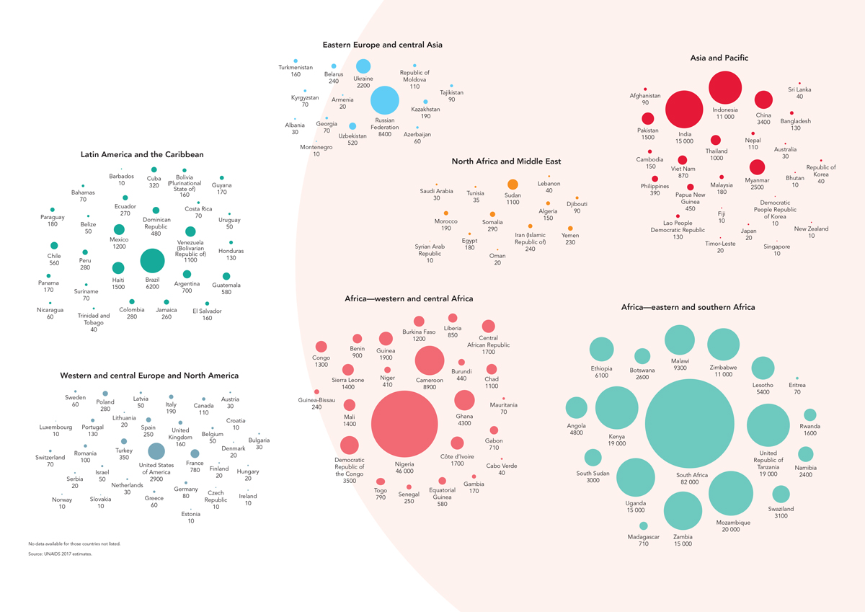
350,000 New Infections Among Girls & Young
Women, 15-24 years, in 2015
Notes:
In reviewing age and gender dissagregations on HIV incidence, of xxxxxx total new infections, 350,000 were among At adolescents and young women and girls, and more than 2/3 occurred in Eastern and Southern Africa.
It is important to note that the elimination of mother to child programme, identified primary HIV prevention interventions as a priority for elimination.
We must reflect on this, because in the current context, the gains being made in eMTCT are being wiped out within 2 decades and further requiring new and potentially higher investments into the future.

Slide 13
Our pathway does not seem to be taking
us where we need to go…
Only 38% of people living with HIV are virally suppressed
Condoms available in SSA cover less than half the need
Two thirds of young women do not have correct comprehensive knowledge of HIV
43% of countries with documented injecting drug use do not have harm reduction programmes
Annual VMMC coverage below target, PrEP coverage <5% of 2020 target
Populations left behind
eMTCT.. far far away
Declining resources………………..
1,700,000 in 2017
Fewer than 500,000 in 2020
Notes:
This is my not so great visual of where we want to be…
And I feel abit like a bearer of bad news with this slide, but it is important to recognize that we have to work differentrly on prevention. We have a crisis and with where we are, and the path we have to take us where we want to go, do not seem to be in tandem

Slide 14
Delivering HIV Prevention
Where are we coming from?
Where are we at now?
What lessons have we learnt?
How will we get there (where we need to go)?

Slide 15
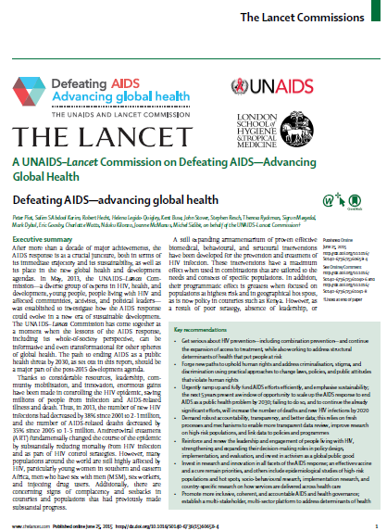
UNAIDS- Lancet Commission 2014 Reviewed the Lessons
“… a biomedical response aimed at rapidly scaling up testing and treatment is essential but will not be sufficient to control the epidemic…”
– Lack of political leadership, commitment and investments in HIV prevention
– Lack of business-style prevention management and service delivery
– Challenges in delivering services to underserved, key and priority populations
Notes:
In 2014, the UNAIDS lancet commission attempted to review and determine why despite the investments and the tools that we have, we are not making the progress that we should have been makin. I wish to point out 3 key items
The one thing clear was that biomedical interventions alone are insufficient to control the epidemic.
So, we know that we can reduce sexual transmission, but investments in primary prevention and the necessary politicat attention are dwindling when we need them most. We see complacency.
It is the perception, and I dare say, perhaps true, that primary prevention is complicated, difficult to measure, includes action beyond the health sector, making action sometimes uncomfortable for those in the health sector. However, it is necessary to address structural barriers that hinder those who are most vulnerable from access to services.

Slide 16
Successes in voluntary medical male circumcision – not celebrated enough, lessons not leveraged enough…
The # in 2017 were 18.6 million MCs are estimated to have prevented 230,000 HIV infections through 2017
Kenya: 868,038, males voluntary circumcised between 2014 - 2017
230,854 –
males VMMC in 2017 – being 121% of 190,333 target coverage
Notes:
We have had successes - The voluntary medical male circumcision programme started slow with a focus on community empowerment and buy-in, with circumcision being a cultural issue. Targeted campaigns were systematically over time.
A global and incoutry roadmaps were developed with clear targets. Services were implemented at scale in the target area.
Today, we have remarkable success today with a coverage of >18 million) and what that has translated to in reduction in new infections for men (and women).
However, we have not celebrated this enough or leveraged the lessons such as the importance of harnessing community leadership that has been key to all VMMC programmes.

Slide 17
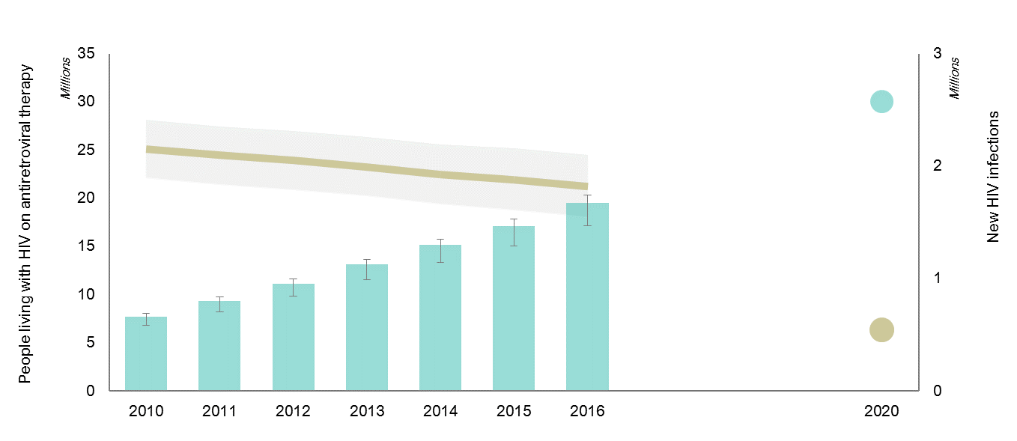
Treatment is essential and must be continued at scale, delivered with high quality, but will not get us the prevention benefits needed quickly enough
UNAIDS modelling (2015)
Phylogenetics: (Fraser C, CROI, 2017)
Swiss Study: (Marzel A et al, 2015)
Quality of treatment/ adherence: (Marks G et al, 2015)
Evidence from high treatment performing countries: e.g. Botswana
2020 Target
2020 Target
Adapted from UNAIDS Gap Reportxxxxxx
Notes:
With regard to scientific advances, more recent advances with Treatment as Prevention study, was key in identifying the importance of ART scale up as an opportunity for HIV prevention.
The results were and remain key in propelling us forward to ensure that the 14million people living with HIV who are not yet on treatment are immediately identified and initiated.
However, the data also tells us that in the real world setting, HPTN 052 results of 96% protection effect may not be attainable.
Recent studies in phylogenetics show that recent HIV infections are at least 30 times more infectious than older infections and we are still far from being able to diagnose acute infections efficiently
(Fraser C, HIV Phylogenetics: Lessons for HIV Prevention. CROI, 2017).
Quality of care and therefore viral suppression at high coverage still remain below the threshold that would facilitate rapid results. Additionally evidence from high treatment performing countries such as Botswana clearly demonstrate the need for targeted primary prevention.
UNAIDS modelling notes that while we are on track for our global treatment targets as denoted by the dotted blue/green line, we will not achieve an inverse incidence reduction within our set timelines.
Before I move on from this slide, I am aware of the false dichotomy we in the HIV response have increasingly created between HIV prevention and treatment.
It worries me sometimes that we discuss HIV in terms of treatment and prevention disparately. I wish to remind us all that we have ONE, ONE, epidemic.
Prevention and treatment are complimentary sides of the same coin.

Slide 18
Differentiated Models of HIV prevention
Where are we coming from?
Where are we at now?
What lessons have we learnt?
How will we get there (where we need to go)? – differentiated models of HIV prevention
Granulation of data; Target setting and accountability;

Slide 19
Kenya’s HIV Prevention Revolution Roadmap
From national to County clusters
High, Medium, Low incidence cluster
From interventions to populations
By age group
From biomedical only to combination prevention
targeted packages at scale
By priority populations
By bridging populations
Timely data on granularity of epidemics
Timely incidence surveillance
faster research to policy translation
coordinated R&D for HIV prevention
From health to HIV prevention as everyone's business
Leverage political leadership
Leverage social movements
Legal and structural reforms
Notes:
I wish to come back to the third perspective that I had on Differntiated HIV prevention.
I fall back to Kenya’s HIV prevention revolution, where the notion of a differentiated approach to the HIV response actually begun, informed by recognizing that we had to do things differently.
In 2014, we recognized that the spray and pray one size fits all approach applied generically for HIV interventions was not delivering on the required results for prevention.
Every 2 years we were increasing the 1.5 million people living with HIV by 10% in Kenya. Important recognition was that the rates of new infections were not evenly distributed across the Country.
Clear and bold HIV prevention targets
Lessons from the successes of ARV treatment and eMTCT
A revolution in execution of HIV prevention programming
From a one size fit all approach
Accountability for HIV prevention results
Beyond the health sector – education, infrastructure
Deliberate decisions to finance HIV prevention

Slide 20
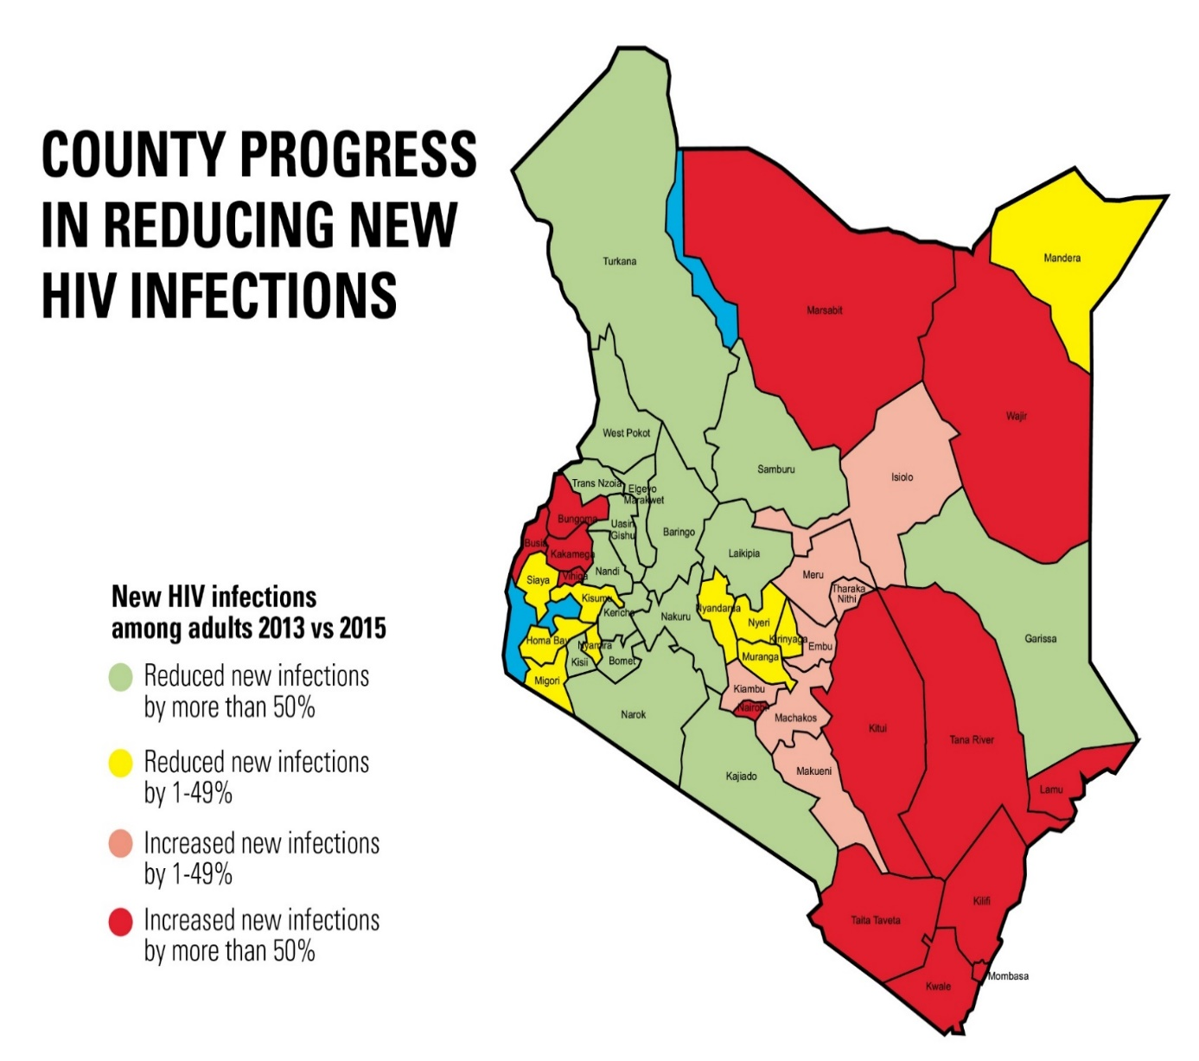
Differentiated models of HIV Prevention: Granulating the national epidemic by County, by risk factors and by Between 2013 and 2015, overall 19% reduction in new infections, but with varied progress… we asked ourselves factors…
New transport Corridor
Border towns with increased trade – County HQs
Railway line
Notes:
We started with granulation of data to understand our epidemic.
We built capacity for data management, modelling and epidemiologic monitoring in-house (at the NACC in Kenya) with support of partners - as opposed to intermittent short-term technical assistance and consultancies
By 2015, we were able to review our data.
In this case, we explored the factors associated with the new increases in numbers of new infections in Kenya – it was immediately noticable that everywhere we had mega infrastructure projects over the period, there was an exponential increase in the rates of new infections.
These factors are outside of the health sector, yet impacting very visibly the outcomes of the health sector

Slide 21
Developing negotiated targets at national and sub-national levels: fewer than… #new HIV infections by County
 | Adults (15+ years) |  |  | Adolescents (10-19) |  |  | Young people (15-24)
County | 2014* | 2017** | 2020*** | 2014 | 2017 | 2020 | 2014 | 2017 | 2020
Baringo | 707 | 353 | 177 | 33 | 16 | 8 | 62 | 31 | 15
Bomet | 1,875 | 938 | 469 | 66 | 33 | 16 | 123 | 61 | 31
Bungoma | 83 | 41 | 21 | 120 | 60 | 30 | 388 | 194 | 97
Busia | 51 | 26 | 13 | 154 | 77 | 39 | 497 | 249 | 124
Elgeyo Marakwet | 400 | 200 | 100 | 26 | 13 | 6 | 48 | 24 | 12
Embu | 518 | 259 | 130 | 167 | 84 | 42 | 315 | 158 | 79
Negotiated process
Routine data based reviews by counties
-Annual number of new HIV infections: County HIV Estimates 2013 for adults and children baseline data; County HIV Estimates 2015 for adolescents (10-19 years) and young people (15-24 years) baseline data
Notes:
The 2nd core element of differentiated models of HIV prevention This applied for AYP, KPs (based on national estimates), condoms, VMMC – all these are available for review

Slide 22
Delivering eMTCT in Kenya
Leadership and political will
Government policy
Culture of accountability
Technical action
County | Need for PMTCT |  |  | on PMTCT |  |  | PMTC coverage targets
 | 2018 | 2019 | 2020 | 2018 | 2019 | 2020 | 2018 | 2019 | 2020
Nairobi | 7,947 | 7,949 | 7,702 | 7,304 | 7,429 | 7,317 | 92% | 93% | 95%
Mombasa | 1,918 | 1,880 | 1,876 | 1,822 | 1,786 | 1,782 | 95% | 95% | 95%
Kwale | 890 | 872 | 870 | 571 | 694 | 826 | 64% | 80% | 95%
Kilifi | 1,523 | 1,492 | 1,489 | 1,185 | 1,289 | 1,415 | 78% | 86% | 95%

Slide 23
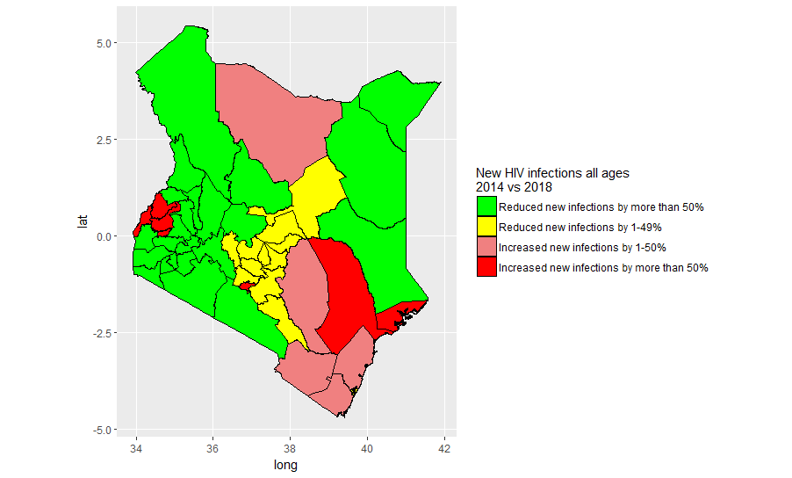
Changes in New HIV Infections for All Ages, 2014 vs 2018

Slide 24
Declining Epidemic Trends in San Francisco: likely PrEP contribution
2004:
Routine
Condom promotion & HIV Testing
2010:
ART
at diagnosis
2013:
PrEP
2007:
HIV
RNA Testing
In San Francisco - the impact of a strong combination of HIV prevention and treatment, with the scale up of HIV PrEP
Adapted from SF DPH, HIV Epidemiology Annual Report 2016
Notes:
We have opportunity for success..
The differentiated application of the tools that we have, targeted at where there is epidemiologic need, towards the populations most in need of the services, delivered at scale, free from stigma and well-informed populations, can have demonstrable results.
For instance, delivery of a combination of HIV prevention with PrEP in high prevalence areas, among key population, with clear targets and tracking/measuring coverage has produced significant results.
In 2012, there were 426 new HIV infections reported in San Francisco; in 2013, the number dropped to 359, and then to 302 in 2014.

Slide 25
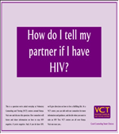
Going back to basics
Do not desert ‘what works’ for the new kid on the block
The story of condoms
Know your HIV status - HIV testing and counselling (the first 90)
Reaching the most underserved – stigma free services and non-judgemental attitudes to all
Countries have capacity and know what works
Community based action
Social contracting or other mechanisms for funding for communities
Lack of systems to demonstrate community contribution

Slide 26
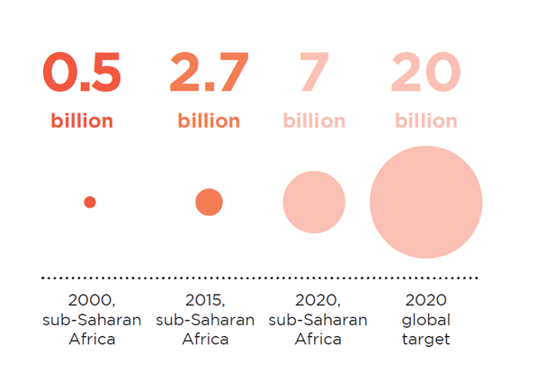
Condoms are effective, cost effective but…
Condom Supply and commodity security
Demand, Access, Utilization and disposal
Monitoring, Tracking and evaluation
County | Number of condoms distributed |  |  |  | Number of condoms distributed per man per year
 | 2017 | 2018 | 2019 | 2020 | 2017 | 2,018 | 2,019 | 2,020
Baringo | 1,540,800 | 3,640,923 | 5,909,908 | 8,358,040 | 8 | 19 | 29 | 40
Bomet | 5,155,200 | 6,810,886 | 8,573,897 | 10,449,640 | 22 | 28 | 34 | 40
Bungoma | 3,016,800 | 7,093,755 | 11,321,946 | 15,705,600 | 8 | 19 | 29 | 40

Slide 27
We have also reduced investments in HIV prevention
Millions

Slide 28
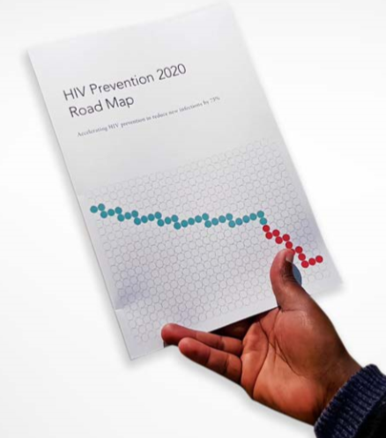
Guidance for delivering differentiated
HIV Prevention
10point action plan
Prevention status assessment
Setting targets
Institutional accountability for HIV prevention
Addressing policy and legal barriers
Consolidated national technical assistance plan
Strengthen social contracting
Defining HIV prevention service packages and delivery platforms
Financing
Monitoring and evaluation
Accountability for all

Slide 29
Global 2020 HIV Prevention Targets & Commitments
(2016 UN Political Declaration on Ending AIDS)
Impact
<500,000 new infections (75% reduction against 2010 baseline).
Programme coverage-access to combination prevention
90% of adolescent girls, young and adult women & men in high-prevalence settings.
90% of key populations
Outputs
20 billion condoms per year ( ̴ 25-50 condoms per male in high- prevalence countries).
3 million people on pre-exposure prophylaxis (10% of persons at risk).
25 (additional) million voluntary medical male circumcisions in 14 countries in Africa (90% coverage among 10-29 year olds).
Financing and sustainability
Allocate one ‘‘quarter’’ of total HIV budget for prevention on average, e.g. 15-30% (depending on relative treatment burden).
Ensure that at least 30% of service delivery is community led by 2030
Notes:
In 2016 at the UN high level meeting, the global community

Slide 30
REINVIGORATING PRIMARY HIV PREVENTION
- Delivering differentiated models HIV prevention
Granulated Data
Targets and Accountability
Enabling policy environment and commitment to equity, equality and rights
Political will
Funds
Accountability
Ensure progress against targets
Commitment
Including for adequate investments
Scale
Ensure prevention programs cover the need
Focus
On geographical areas and populations at elevated risk
Innovation
New approaches to increase effectiveness
Synergies
Effective program packages
Notes:
This is a summary slide from our combination prevention publication in 2015. If there is political commitment to scale up effective program packages focussing on those populations and locations most in need and hold each other accountable for reaching the targets we have have committed ourselves, we can bring new infections down to less than 500.000 by 2020.

Slide 31
Acknowledgements
NACC Colleagues –
Emmy Chesire, Celestine Mugambi, Ezekiel Mwabili, Kennedy Mutai, George Onyango
Kenya HIV Prevention Working Group
SI/Situation Room working group Kenya-Condom working group Kenya
Karl Dehne and Global Prevention Coalition
Wanjiru Mukoma
Rachael Baggerly
Sheena Mackomic
Notes:
As the HIV response is a partnership, so has this presentation been. While I have had the honor to stand here and give the presentation, it is a result of many people who reviewed it, shared your insights and slides. I may not name each person, I am thankful.
I thank my colleagues at the NACC whose dedications and commitment contributes to the insights that I consistently gain and the stakeholders of the HIV response, especially communities of persons living with HIV, for your partnership and support.
I once again thank you all.

